Slide 1
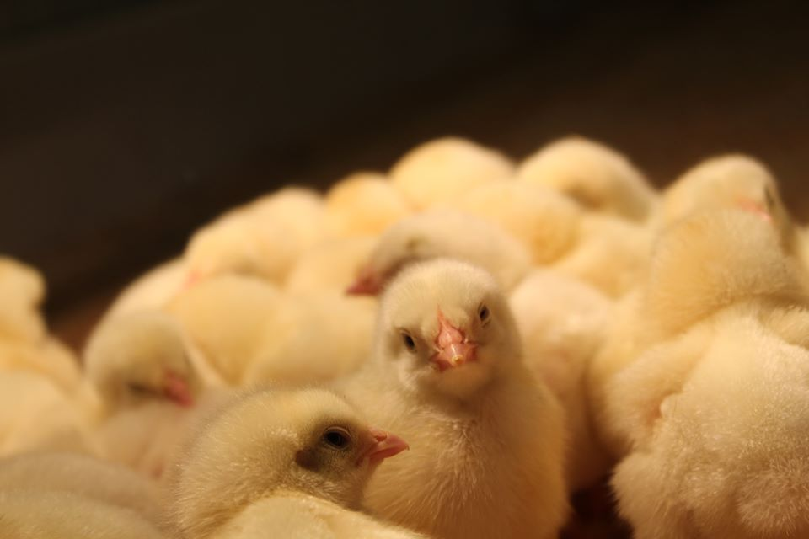
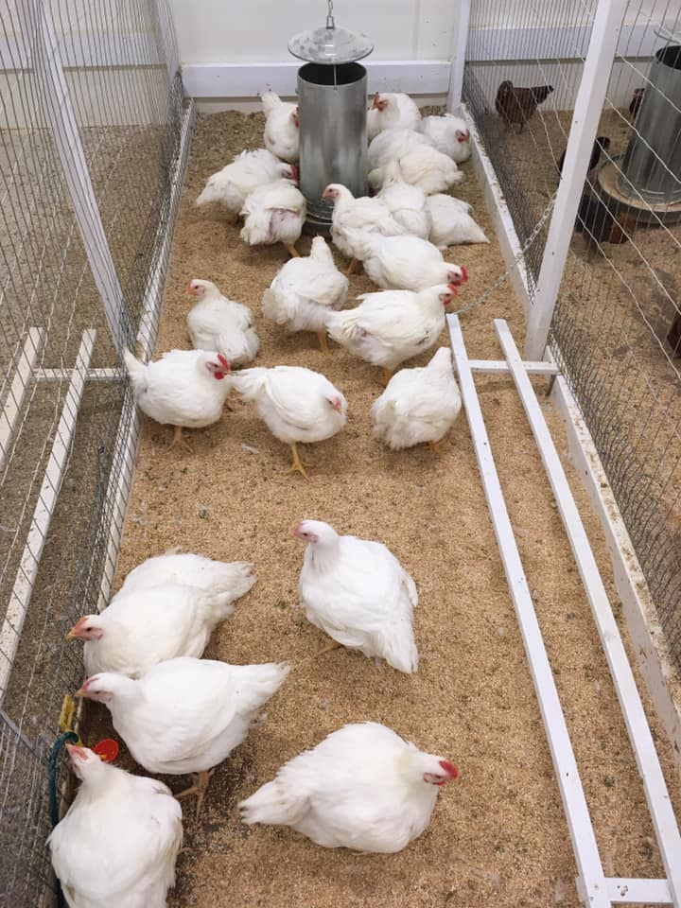
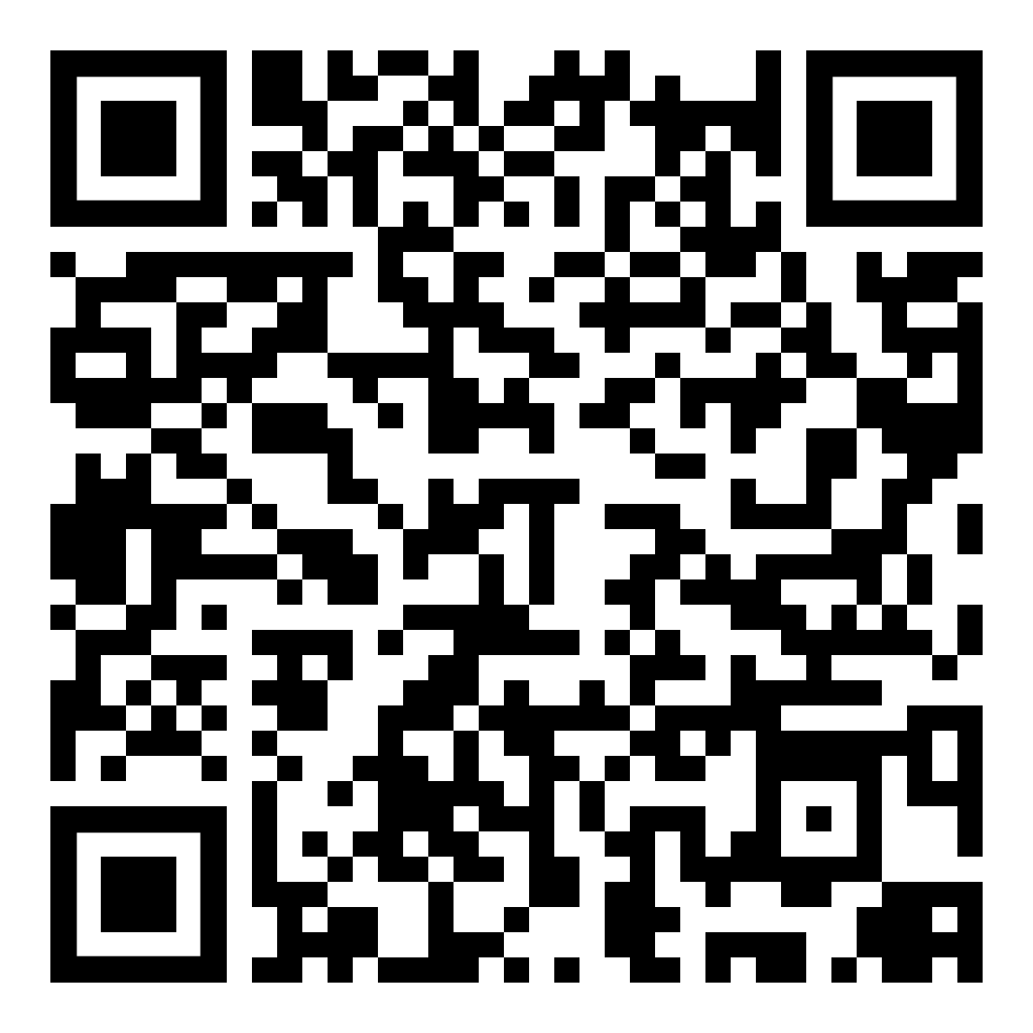
Clucks to Bucks
Simulating a School-Based Enterprise SAE
Introduction
SAE is an essential component of a balanced Ag Ed program
Some students pursue a career in agricultural education with no prior Ag Ed experience (including SAE experience)
Changes made by SAE for All require all Ag Ed students to reconceptualize SAE
Exposure to new SAE areas will benefit all Ag Ed students
Engagement in SAE would lead to opportunities for experience, reflection, thinking, and hopefully, experimentation.
Innovation
Students enrolled in our undergraduate junior-level advising FFA/SAE course in the fall of 2019 were tasked with raising broiler chickens as a simulated School-Based Enterprise SAE.
Fall 2019 Timeline
September 12th First in-class planning meeting | -Designated roles (ex. Team leader, scribe, animal husbandry manager) -Established group norms/expectations and selected methods of communication between members -Started the business plan (outlined in SBE Independent Learning Guide) -Assigned independent work
September 26th Second in-class planning meeting | -Shared independent work -Compiled findings -Planned the Board of Directors presentation -Established an out-of-class practice time
October 3rd Board of Directors Meeting (School of Education faculty and staff) | -Students co-presented their proposed business plan which included a business description, market analysis, competitor analysis, budget, and an operating plan -Students shared their goals and intended learning outcomes with the Board of Directors -Students requested a “loan” from the Board of Directors
October 9th Chicks arrive | -Started with 28 Cornish Rock Hybrid chicks -Housed at NDSU Animal Nutrition and Physiology Center -Students organized and managed the care schedule which included daily chores -Students posted daily updates in a Facebook group as a form of communication.
November 21st Processing Day | -25 birds survived to processing -Students and instructors processed the birds with the assistance and supervision of the ANPC facility manager and student staff -Students sold processed birds for $15 through a pre-order process
December 10th Final Board of Directors Meeting | -Students co-presented a summary of the business experience to the board of directors -Shared final income and expense report, learning outcomes, summary of their experience, and recommendations they would make to a teacher who wanted to do the same project
Concrete Experience
Reflective Observation
Abstract Conceptualization
Active Experimentation
Costs/Resources
Chickens were housed at NDSU Animal and Nutrition Physiology Center
Collaborated with Animal Science Faculty and Staff
Worked with IACUC Board to achieve certifications for working with livestock on campus
Budget
Expenses
Chicks | $86
Feed/Bedding/Housing | $72
Total | $158
Income
Processed Chicken Sold (18 @ $15 each) | $270
Processed Chicken Used at Home (7) | $0
Total | $270
Total Profit | $112
Results
10 students were involved in the project over the course of the semester.
Students expressed positive outcomes from the project.
Students assessed their peers based upon the group norms they established at the first in-class planning meeting.
Students self-assessed their level of growth related to the identified learning objectives.
Instructors noticed deeper conversations about SAEs and their purpose in SBAE.
Future Plans/Advice to Others
We intend to implement this project again in the Fall of 2020
Opportunities exist to expand this concept beyond poultry production (growing bedding plants or offering a business service)
Potential exists to engage students in other new SAE areas (Service Learning or Agriscience Research)
If you choose to use this innovation in your own program
Set clear expectations and be intentional when scaffolding
Allow students to have a voice in the learning outcomes, goals, and team norms
Brooke L. Thiel & Adam A. Marx
North Dakota State University
Brooke.Thiel@ndsu.edu
Adam.Marx@ndsu.edu

